Slide 1
SKILL 2.2: DESCRIBE SOME OF THE CORE PRODUCTS AVAILABLE IN AZURE

Slide 2
Executive summary
The core Azure products in 4 different categories
Azure compute
Azure networking
Azure storage
Azure database
This refers to the resources that provide computing power to run your applications. Azure offers both IaaS and PaaS compute products.
These products provide connectivity between Azure resources, and to and from the Internet or your on-premises resources.
These products give you secure and reliable cloud storage for your data..
These products provide highly-scalable solutions for hosting databases of many varieties.
Source: …

Slide 3
Agenda
Updates to the template

Slide 4
Azure Compute products
Allow you to easily and dynamically allocate resources that are needed for any computing task.
You can create compute resources quickly when you need them, and when your needs grow
You can scale those resources to handle additional requirements.
By using Azure compute resources for your computing needs, you can more easily control costs because you don’t pay for resources unless you need them.
Can also allocate infrastructure much more quickly than you can in the on-premises world
Some examples of compute products in Azure are Azure Virtual Machines, Azure App Service, container offerings in Azure, and serverless computing

Slide 5
Azure Compute products
A virtual machine (VM) is a software-based computer that runs on a physical computer. The physical computer is considered the host, and it provides the underlying physical components such as disk space, memory, CPU power, and so on. The host computer runs software called a hypervisor that can create and manage one or more VMs, and those VMs are commonly referred to as guests.
By using Azure Virtual Machines, you can take advantage of powerful host computers that Microsoft makes available when you need computing power, and when you no longer need that power, you no longer have to pay for it.
The Azure portal is actually using an ARM template to deploy your VM. That ARM template contains parameters that are replaced with the information you entered for your VM.
You are charged for Azure VMs as long as they are running. To stop billing for this VM, click the Stop button.
Azure virtual machines

Slide 6
Azure Compute products
As of right now, this VM is susceptible to downtime due to three types of events: planned maintenance, unplanned maintenance, and unexpected downtime.
Planned maintenance
refers to planned updates that Microsoft makes to the host computer. This includes things like operating system updates, driver updates, and so on. In many cases, updates won’t impact your VM, but if Microsoft installs an update that requires a reboot of the host computer, your VM will be down during that reboot.
Unplanned maintenance
Azure has underlying systems that constantly monitor the health of computer components. If one of these underlying systems detects that a component within the host computer might fail soon, Azure will flag the computer for unplanned maintenance. In an unplanned maintenance event, Azure will attempt to move your VM to a healthy host computer. When it does this, it preserves the state of the VM, including what’s in memory and any files that are open. It only takes Azure a short time to move the VM, during which time it’s in a paused state. In a case where the move operation fails, the VM will experience unexpected downtime.
Azure virtual machines

Slide 7
Azure Compute products
In order to ensure reliability when a failure occurs in a rack within the Azure datacenter, you can (and you should) take advantage of a feature called availability sets. Availability sets protect you from maintenance events and downtime caused by hardware failures. To do that, Azure creates some underlying entities in an availability set called update domains and fault domains.
Fault domains are a logical representation of the physical rack in which a host computer is installed. By default, Azure assigns two fault domains to an availability set. If a problem occurs in one fault domain (one computer rack), the VMs in that fault domain will be impacted, but VMs in the second fault domain will not be. This protects you from unplanned maintenance events and unexpected downtime
Update domains are designed to protect you from a situation where the host computer is being rebooted. When you create an availability set, Azure creates five update domains by default. These update domains are spread across the fault domains in the availability set. If a reboot is required on computers in the availability set (whether host computers or VMs within the availability set), Azure will only reboot computers in one update domain at a time and it will wait 30 minutes for computers to recover from the reboot before it moves on to the next update domain. Update domains protect you from planned maintenance events.
Azure virtual machines
- Availability Set

Slide 8
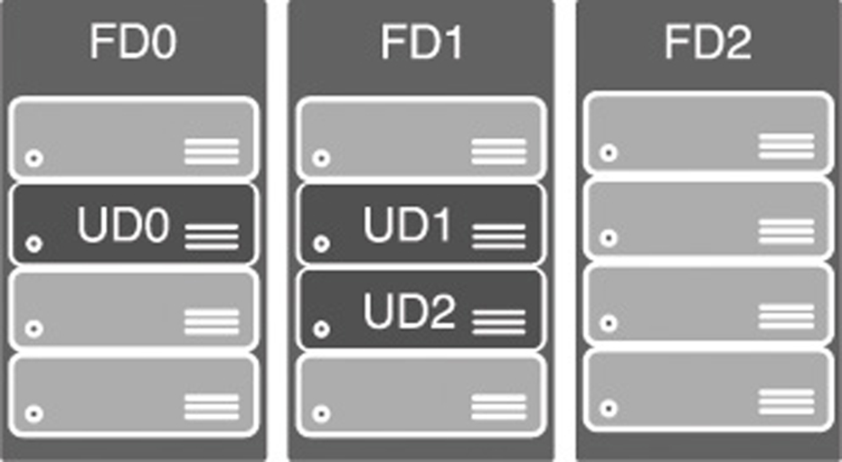
Azure Compute products
Azure virtual machines
Azure virtual machines
- Availability Set
The fault domains FD0, FD1, and FD2 encompass three physical racks of computers. UD0, UD1, and UD2 are update domains within the fault domains.

Slide 9
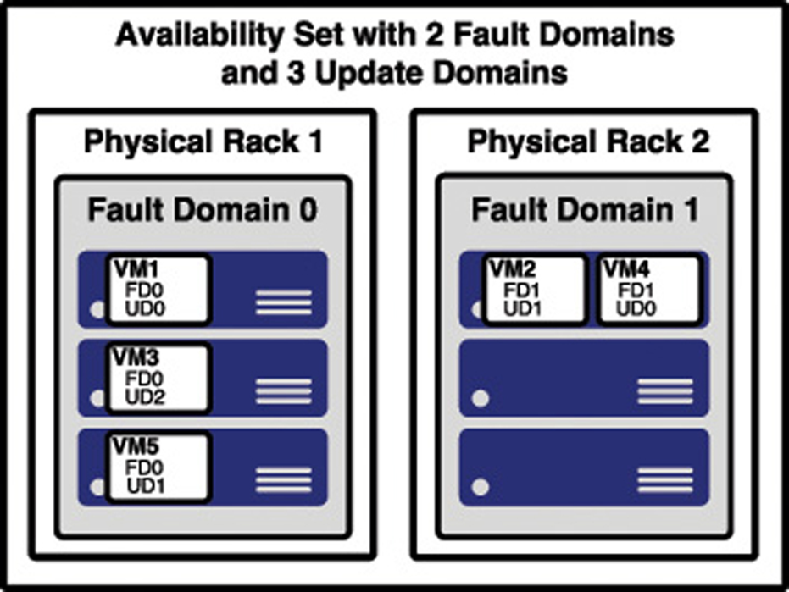
Azure Compute products
Azure virtual machines
The figure shows a better representation of an availability set, with five VMs in the availability set. There are two fault domains and three update domains. When VMs were created in this availability set, they were assigned as follows:
The first VM is assigned Fault Domain 0 and Update Domain 0.
The second VM is assigned Fault Domain 1 and Update Domain 1.
The third VM is assigned Fault Domain 0 and Update Domain 2.
The fourth VM is assigned Fault Domain 1 and Update Domain 0.
The fifth VM is assigned Fault Domain 0 and Update Domain 1.
Azure virtual machines
- Availability Set

Slide 10
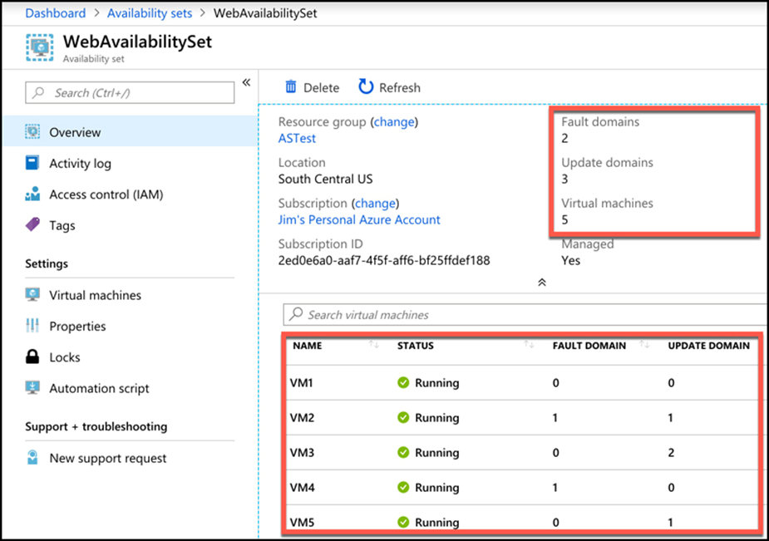
Azure Compute products
You can verify the placement of fault domains and update domains by creating five VMs in an availability set with two fault domains and three update domains.
Azure virtual machines
Azure virtual machines
- Availability Set

Slide 11
Azure Compute products
Some disadvantages of Availability sets:
Every machine in an availability set has to be explicitly created. While you can use an ARM template to deploy multiple virtual machines in one deployment, you still have to configure those machines with the software and configuration necessary to support your application.
An availability set also requires that you configure something in front of your VMs that will handle the distribution of traffic to those VMs. For example, if your availability set is servicing a website hosted on the VMs, you’ll need to configure a load balancer that will handle the job of routing users of your website to the VMs that are running it.
Higher cost. You might pay for many more VMs than you need.
Azure virtual machines
Azure virtual machines
- Availability Set

Slide 12
Azure Compute products
Azure offers another feature for VMs called scale sets that solves the problems of Availability sets nicely.
When you create a scale set, you tell Azure what operating system you want to run and then you tell Azure how many VMs you want in your scale set. You have many other options such as creating a load balancer or gateway and so forth. Azure will create as many VMs as you specified (up to 1,000) in one easy step.
Scale sets are deployed in availability sets automatically, so you automatically benefit from multiple fault domains and update domains. Unlike VMs in an availability set, however, VMs in a scale set are also compatible with availability zones, so you are protected from problems in an Azure datacenter.
You can also scale a scale set in a situation where you need more or fewer VMs. You might start with only one VM in a scale set, but as load on that VM increases, you might want to automatically add additional VMs. Scale sets provide that functionality by using Azure’s auto-scale feature. You define scaling rules that use metrics like CPU, disk usage, network usage, and so forth. You can configure when Azure should add additional instances and when it should scale back and deallocate instances. This is a great way to ensure availability while reducing costs by taking advantage of the elasticity that auto-scale provides.
Azure virtual machines
Azure virtual machines
- Scale Sets
Notes:
https://docs.microsoft.com/azure/virtual-machine-scale-sets/virtual-machine-scale-sets-deploy-app#build-a-custom-vm-image.

Slide 13
Azure Compute products
One of the most complex aspects of moving to the cloud is dealing with the complexities of moving to a new environment. To help with this problem and to make it easier to shift applications into new environments, the concept of containers was invented.
In order to run an application in a container, a computer needs to have a container runtime installed on it. The most popular container runtime is Docker, a runtime developed and maintained by a company called Docker Inc. Docker not only knows how to run applications in containers, but it also enforces certain conditions to ensure a secure environment.
Each container operates within an isolated environment. It has its own network, its own storage, and so on.
Containers
Notes:
You aren’t limited to your own images. In fact, Docker runs a repository of images that you are free to use in your own applications. You can find it at: https://hub.docker.com.

Slide 14
Azure Compute products
Azure offers numerous technologies for hosting containers.
Azure Container Instances (ACI) is a PaaS service that makes it easy to start a container with minimal configuration. You simply tell ACI where to find the image (using either a Docker tag or a URL to the image) and some basic configuration for the VM you want the container to run on.
Azure creates server resources as needed to run your container, but you’re not paying for an underlying VM. Instead, you pay for the memory and CPU that your container uses.
ACI is designed to work with simple applications. You can define a container group and run multiple containers within an ACI instance, but if you have an application that is used heavily by many people and that might need to take advantage of scaling, ACI isn’t a good choice for you. Instead, Azure’s Kubernetes Service (AKS) would be a better choice
Containers
Notes:
You aren’t limited to your own images. In fact, Docker runs a repository of images that you are free to use in your own applications. You can find it at: https://hub.docker.com.

Slide 15
Azure Compute products
Kubernetes is a container orchestration service. This means that it’s responsible for monitoring containers and ensuring that they’re always running. It can also scale to add additional containers when the needs require it to, and it can then scale back when the needs are reduced.
Kubernetes creates containers in a pod. A pod is a group of related containers, and containers within a pod are able to share resources. This is one of the advantages to using Kubernetes, because it releases you from the resource-sharing restriction typically imposed in a multi-container environment. However, a container in one pod is not able to share resources with a container in another pod.
The computer that Kubernetes pods are running on is called a node or a worker. This computer must have a container runtime such as Docker running on it. In addition to pods, the node also runs several services that are required for Kubernetes to manage the pods, and so on
Containers
Notes:
You aren’t limited to your own images. In fact, Docker runs a repository of images that you are free to use in your own applications. You can find it at: https://hub.docker.com.

Slide 16
Azure Compute products
Kubernetes is a container orchestration service. This means that it’s responsible for monitoring containers and ensuring that they’re always running. It can also scale to add additional containers when the needs require it to, and it can then scale back when the needs are reduced.
Kubernetes creates containers in a pod. A pod is a group of related containers, and containers within a pod are able to share resources. This is one of the advantages to using Kubernetes, because it releases you from the resource-sharing restriction typically imposed in a multi-container environment. However, a container in one pod is not able to share resources with a container in another pod.
The computer that Kubernetes pods are running on is called a node or a worker. This computer must have a container runtime such as Docker running on it. In addition to pods, the node also runs several services that are required for Kubernetes to manage the pods, and so on.
There will typically be multiple nodes within a Kubernetes instance, and they are all controlled by a master node called the Kubernetes master. The entire environment of the master and all of its nodes is called a Kubernetes cluster.
Containers
Notes:
You aren’t limited to your own images. In fact, Docker runs a repository of images that you are free to use in your own applications. You can find it at: https://hub.docker.com.

Slide 17
Azure Compute products
A Kubernetes master contains all of the configuration and services necessary to manage the orchestration of pods and other Kubernetes entities. Configuring a master can be complex, and it is by far the most laborious task of using Kubernetes. For that reason, services such as Azure Kubernetes Service (AKS) are becoming more popular.
AKS offloads the burden of dealing with the Kubernetes master to Microsoft. When you create a Kubernetes cluster in AKS, Azure creates the master and the nodes for you. All you have to do is deploy your containers, and you’re up and running with a managed Kubernetes cluster.
While AKS makes adopting and managing Kubernetes easier, it doesn’t completely obfuscate Kubernetes. In order to deploy your applications, you still need to understand how to use Kubernetes, and in some cases you’ll need to use the Kubernetes command line. Azure, however, makes it far easier than doing all of the legwork and maintenance yourself. Even better, AKS in Azure is free. You only pay for the Azure computer for resources that you use within your cluster.
Containers
Notes:
You aren’t limited to your own images. In fact, Docker runs a repository of images that you are free to use in your own applications. You can find it at: https://hub.docker.com.

Slide 18
Azure Compute products
For a true PaaS experience in container hosting, Microsoft offers Web App for Containers, a feature of Azure App Service. When you create a Web App for Containers app, you specify the OS you want (either Windows or Linux) and you specify the location of the Docker image.
Microsoft manages the infrastructure that’s involved, so you only have to worry about the application contained in the image.
Unlike ACI, you pay for Azure App Service whether you’re using the application or not, because your application is running on a dedicated VM in App Service. That VM is associated with an App Service plan, and each App Service plan is associated with a specific pricing tier. You can change the pricing tier of your App Service Plan at any time.
Another benefit of using Web App for Containers is that, because it’s a true PaaS service, it offers many turnkey features that you can use in your application without having to deal with complicated development or configuration issues.
Containers
Notes:
You aren’t limited to your own images. In fact, Docker runs a repository of images that you are free to use in your own applications. You can find it at: https://hub.docker.com.

Slide 19
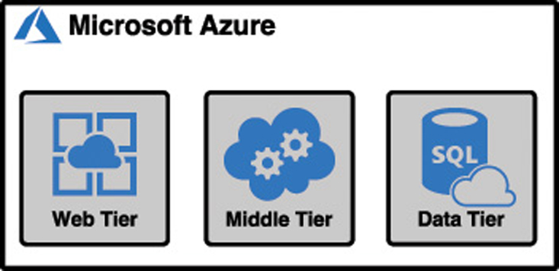
Azure Networking products
Applications should be designed using a loosely-coupled architecture.
In a loosely-coupled architecture, each component of an application can be replaced or updated without breaking the application. In order to design applications in this way, you have to separate out the various components, and they need to operate in their own tier of the application. Applications designed in this way are referred to as N-tier applications.

Slide 20
Azure Networking products
An Azure virtual network (often called a VNET) allows Azure services to communicate with each other and with the Internet. You can even use a VNET to communicate between your on-premises resources and your Azure resources.
When you created the virtual machine earlier in this chapter, Azure created a VNET for you. Without that VNET, you wouldn’t be able to remote into the VM, or use the VM for any of your applications.
You can also create your own VNET and configure it any way you choose.
An Azure VNET is just like any other computer network. It’s comprised of a network interface card (a NIC), IP addresses, and so on. You can break up your VNET into multiple subnets and set up a portion of your network’s IP address space for those subnets. You can then configure rules that control the connectivity between those subnets.
In most cases, you create VNETs before you create the resources that use them.
A public IP address doesn’t have to be assigned to a resource in order for that resource to connect outbound to the Internet. Azure maintains a pool of public IP addresses that can be dynamically assigned to a resource if it needs to connect outbound.
Azure Virtual network

Slide 21
Azure Networking products
App Service takes care of ensuring that load is distributed across all of the VMs we’re using. App Service uses a load balancer to do this, and one of the advantages of choosing a PaaS offering for the web tier is that you don’t have to worry about Managing it.
This kind of configuration is typical in order to maintain high-availability in your application, but it does add an additional layer of complexity.
Since each of these VMs has its own public IP address, a user is going to use only one VM. Ideally you have a system in place that ensures if one of these VMs experiences a problem, any traffic is sent to the other VMs.
In addition to that, when there’s high load, you want to spread the load across all three of these VMs. The solution to this problem is to use Azure LoadBalancer.
Azure Load Balancer

Slide 22
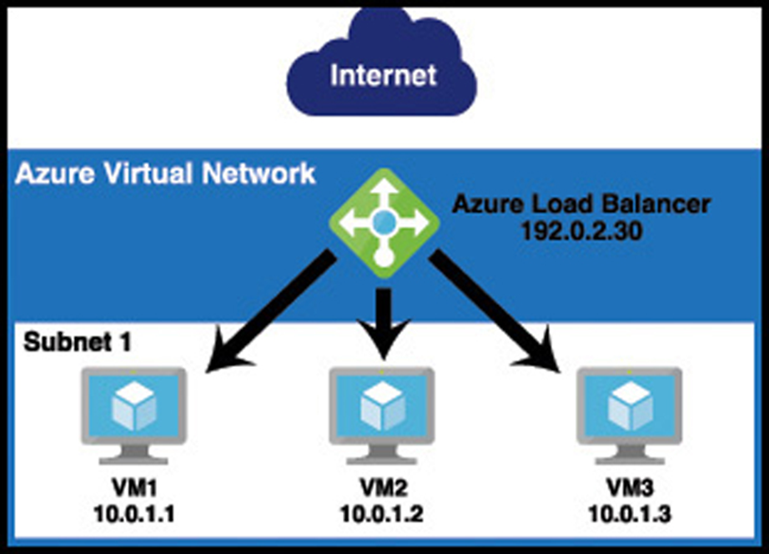
Azure Networking products
Azure Load Balancer is inside of the VNET, but it sits between the user and the subnet. When a user connects to the web tier, she connects to the load balancer’s IP address, not the IP address of one of my VMs. The load balancer routes requests into the web tier to the VMs, and it can use rules to ensure that traffic is equally distributed between them. If one of the VMs goes down and doesn’t respond, the load balancer can send that traffic to another VM without the user even realizing there’s a problem.
Azure Load Balancer

Slide 23
Azure Networking products
Azure Application Gateway is a load balancer that’s specifically designed to deal with HTTP traffic. Because Application Gateway understands HTTP traffic, it can make decisions based on that HTTP traffic. For example, Application Gateway can:
Route traffic to a specific VM or pool of VMs based on the URL.
Use a cookie to ensure that a user is always routed to the same VM in a situation where that VM contains state information on that user that must be maintained.
Display a customized error page, complete with your company branding, when a page isn’t found or when an error occurs.
Handle the SSL traffic for your site so that your application tiers don’t have the overhead of dealing with decrypting traffic
You can also add Web Application Firewall (WAF) to Application Gateway. WAF is designed to stop known vulnerabilities from making it into your VNET, allowing you to operate in a more secure environment. If a request attempts to enter your network and it’s determined to be a threat, it’s rejected at the gateway and never makes it to your application.
Azure Application Gateway

Slide 24
Azure Networking products
In some cases, you may need your application hosted in Azure to talk to an on-premises resource.
VPN Gateway connects your on-premises resources to your Azure VNET using a virtual private network, or VPN. Traffic that flows over this VPN is encrypted. There are multiple configurations for VPN Gateway connections:
Connection Type | Description
Site-to-Site VPN (S2S) | Connects your VNET to a single on-premises location. Requires a VPN with public-facing IP address on-premises. A multi-site variant allows you to connect to multiple on-premises locations.
Point-to-Site VPN (P2S) | Connects one specific on-premises client PC to your VNET. Multiple clients can connect, but each one connects over its own VPN client.
VNET-to-VNET | Connects two Azure VNETs to each other. Useful in situations where you have two VNETs in different Azure regions and you want to securely connect them.
VPN Gateway
Notes:
As an alternative to using VNET-to-VNET connections, you can use VNET peering to establish communication between two Azure VNETs in the same region, and you can use global VNET peering to connect VNETs in different Azure regions.
For more information on VNET peering, see https://docs.microsoft.com/azure/virtual-network/virtual-network-peering-overview

Slide 25
Azure Networking products
Azure Content Delivery Network

Slide 26
Azure Networking products
Azure Traffic Manager

Slide 27
Azure Storage products

Slide 28
Azure Database Products

